Slide 1
Used Car prices
Chang Liu

Slide 2
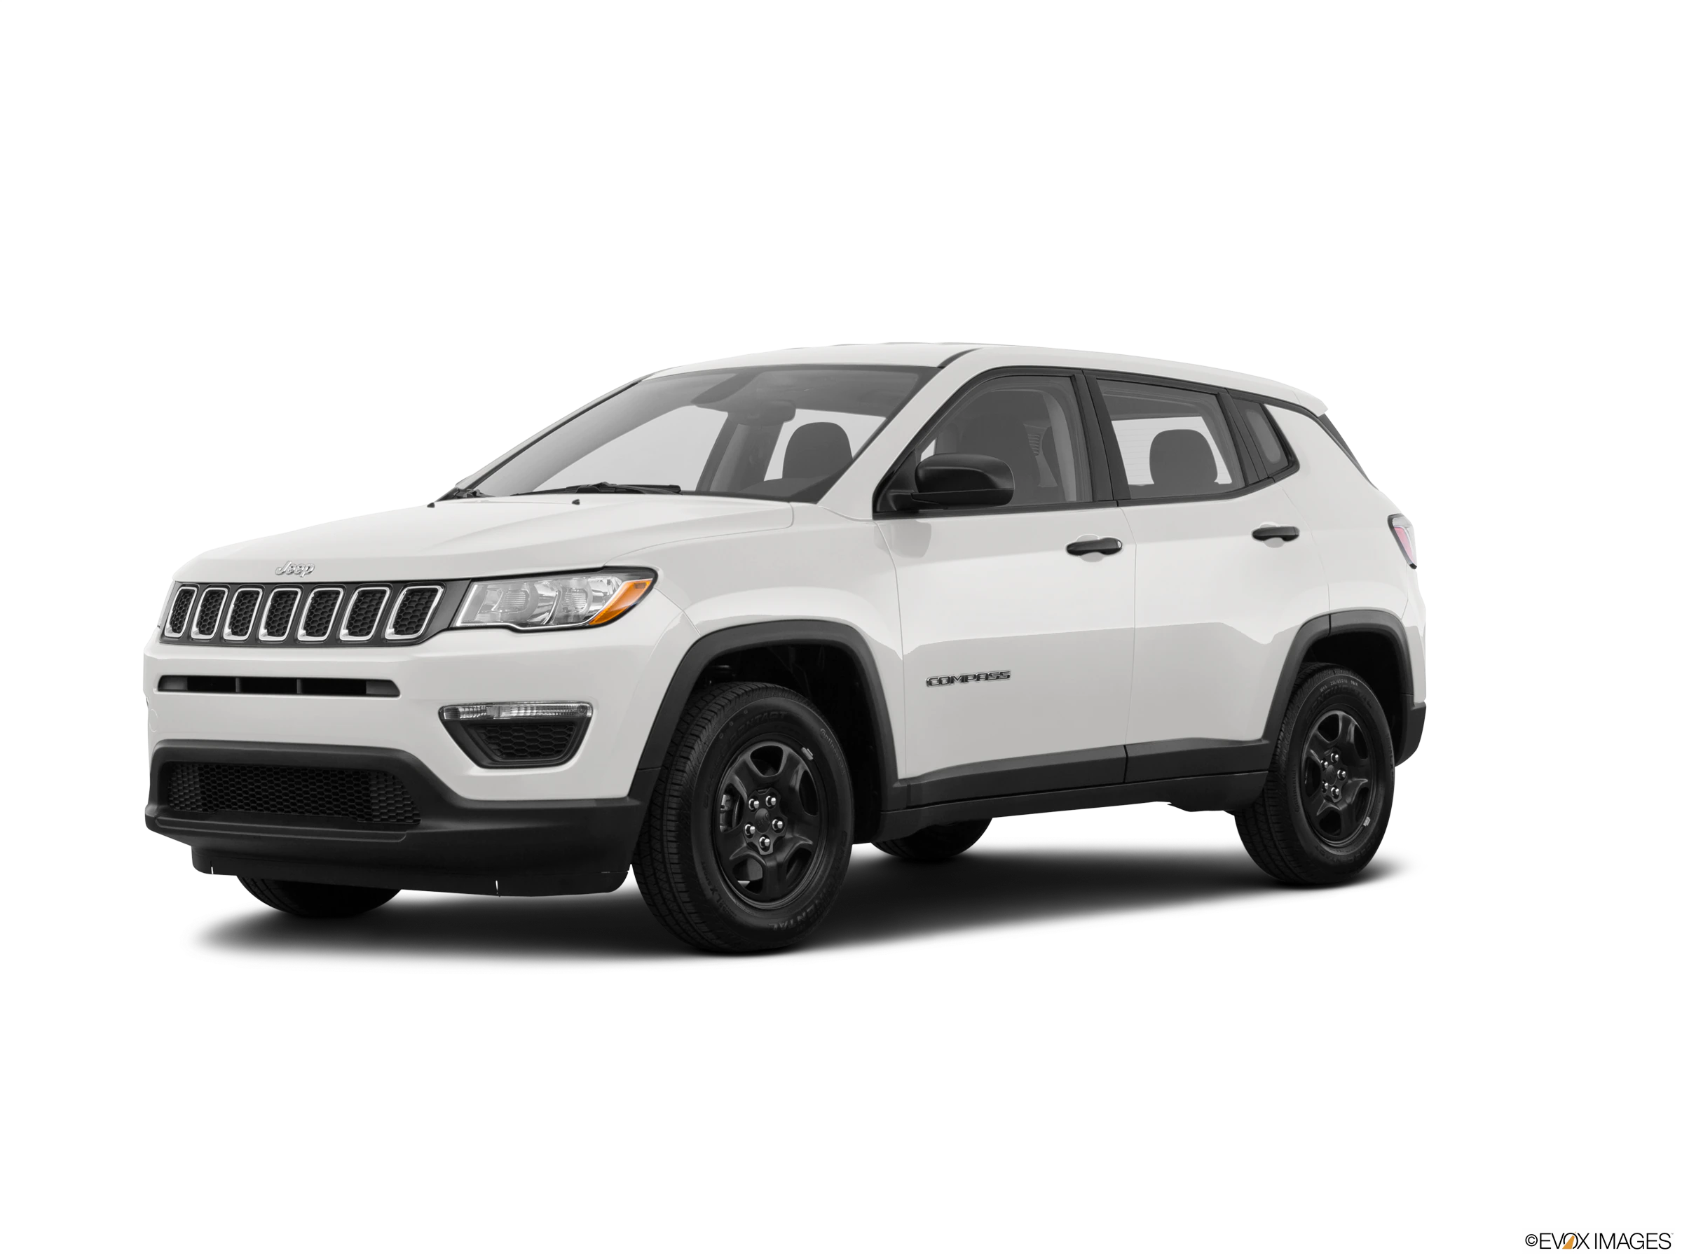
Did I spend too much？

Slide 3

Problem statement
Kaggle :https://www.kaggle.com/tunguz/used-car-auction-prices
Car auction sales prices from 2014-2015

Slide 4
Structure
Year made | Year that vehicle was made. Eg: 2014
Make | Vehicle make. Eg: Honda, Ford, Mercedes
Model | Vehicle Model. Eg: CR-V
Body | Vehicle type. Eg: SUV
Transmission | Either “manual” or “Automatic”
Vin | Vehicle ID
State | State that vehicle was hold
Condition | Vehicle condition rate from 1 – 5 point
Odometer | Miles vehicle has been driven
Color | Vehicle outer color
MMR | Machine predicted selling price
Selling price | Final selling price
Sell_month | Month that vehicle was sold
Sell_year | Year that vehicle was sold
14 Columns
490197 rows

Slide 5
Goal
Descriptive Analysis
Vehicle Overall condition
Vehicle Final Selling price
Etc.
Predictive analysis
Given a year, made, model , body, condition and odometer, we predict the vehicle price

Slide 6
Data cleaning
Delete empty rows
Delete duplicated rows
Remove columns that are not helpful for prediction:
Vin number(vehicle ID)
State
Transmission
Color
Sell Month and Year

Slide 7

Cleaned Data
7 variables
422920 objects
Independent: Year, make, model, body, condition, odometer
Dependent: Selling Price

Slide 8
Data Cutting
Cut each variable into several chucks

Slide 9
Data Cutting Example
Cut the variable Condition into 6 categories:
0 to 1 | Terrible
1 to 2 | Poor
2 to 3 | Neutral
3 to 4 | Good
4 to 4.5 | Great
4.5 to 5 | Excellent

Slide 10
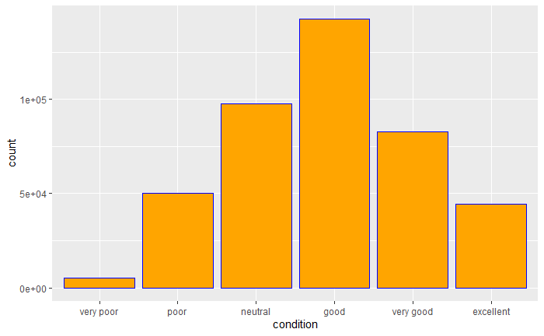
Histogram of conditions
Close to Normal distribution

Slide 11
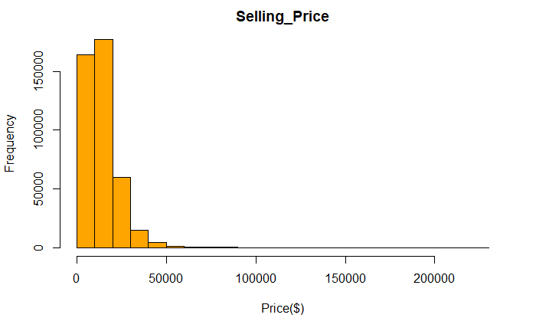
Selling Price
Right skewed

Slide 12
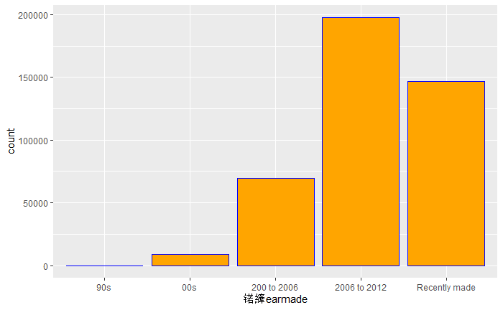

Year vehicle was made
Buying used vehicle mainly made from the past 10 year

Slide 13

Prediction
Split data into training set and test set
75% data for training set
25% data for testing set
Naïve Bayes, Random Forest and KNN

Slide 14

Result
After tuning parameters:
Naïve Bayes:
Accuracy (average) : 0.9998
KNN:
Accuracy (average) : 0.6820
Random Forest:
Accuracy (average) : 0.5772

Slide 15
Application
Year made | make | model | body | condition | odometer | Selling price
recently made | Jeep | compass | SUV | very good | 30000-50000 miles
recently made | Chevrolet | Silverado | crew cab | excellent | 10000-30000 miles
Two rows' data from vehicles I have owned in the U.S.

Slide 16
Application
2018
Jeep Compass
30000 miles
Condition 4.1/5
Predicted:
25000 - 30000
Price I spend:
25300

Slide 17
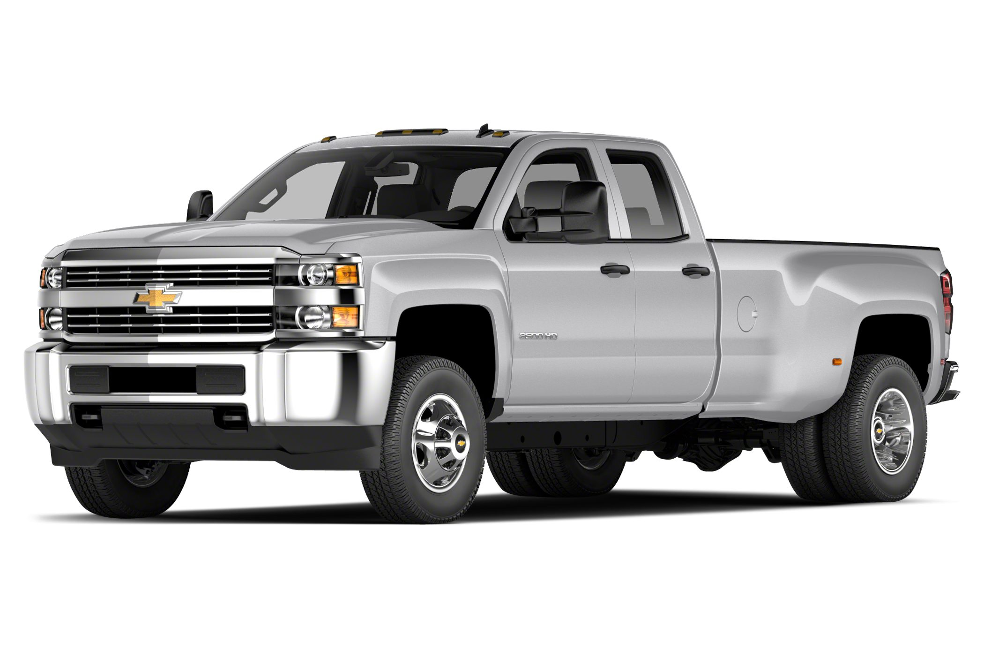
Application
2016
Chevy Silverado
10000 miles
Condition 4.7/5
Predicted:
25000 - 30000
Price I spend:
32000

Slide 18
Thank you

